Slide 1

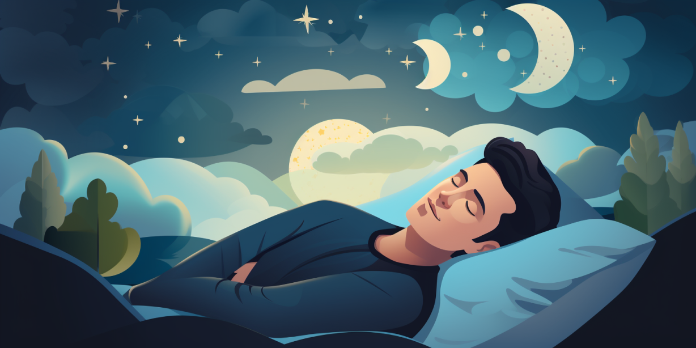
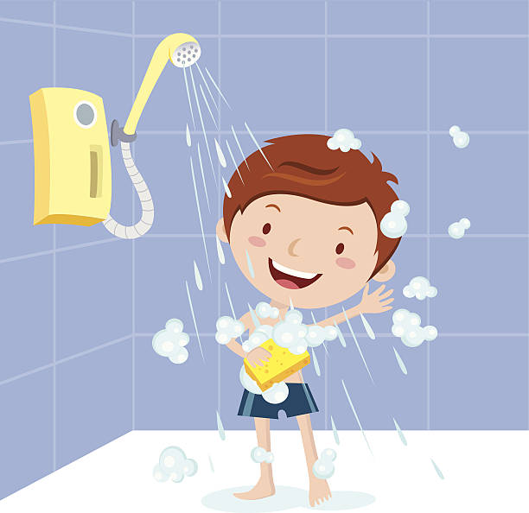

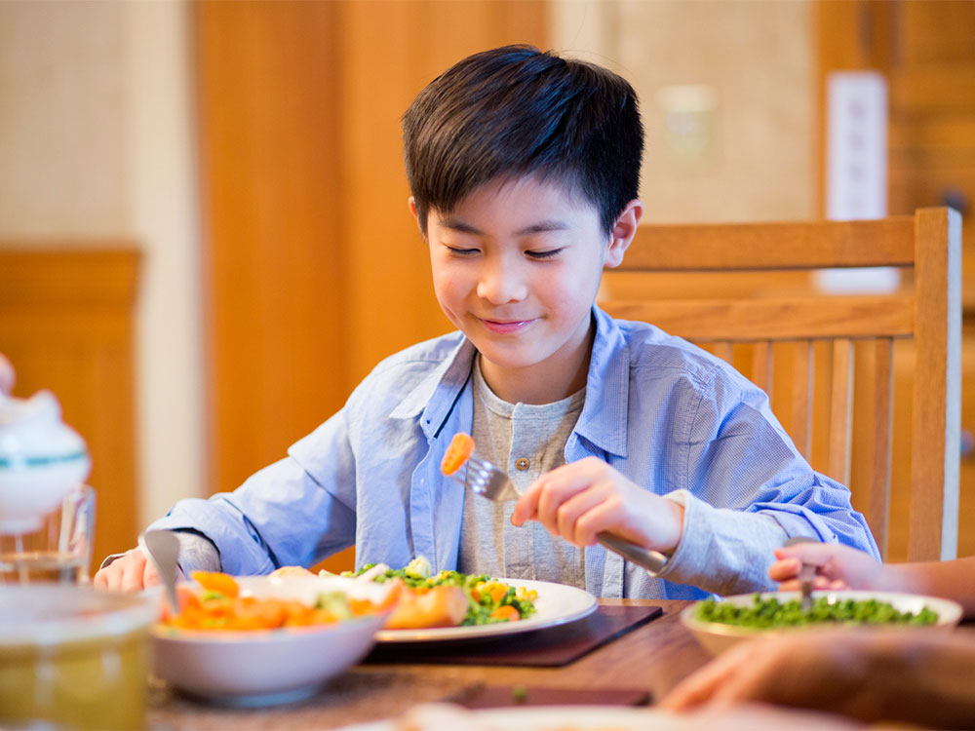

STORYBOARD
HEALTHY LIFESTYLE
REGULAR EXERCISE
GOOD SLEEP
SHOWER TWICE A DAY
DAILY DRINKING WATER
EAT HEALTHY PROTEIN
CLEAN LIFE

